Slide 1

Pathways of Interpreting
Katie MacVittie

Slide 2
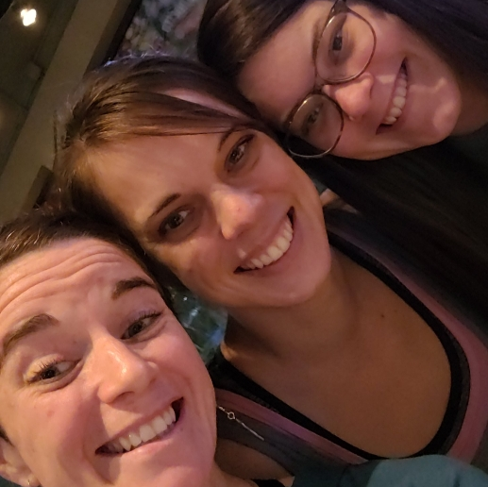
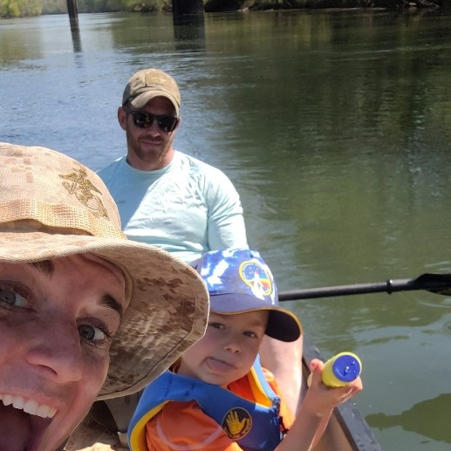
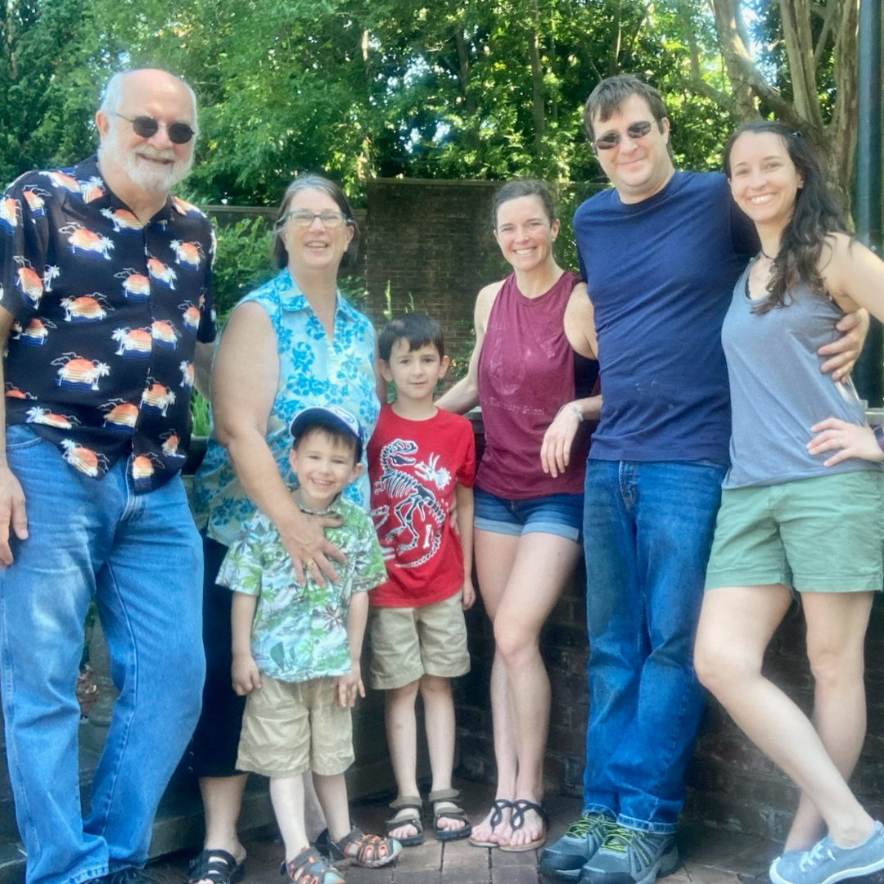
Background

Slide 3




Introduction
This workshop will outline the scope, including pros and cons, of working as an interpreter; along with common situations that interpreters encounter and how to deal with them.

Slide 4

Education

Slide 5
Pros
Stable (work, pay, SL, AL, benefits, schedule)
Extended holidays
Other work options during summer/holidays
Benefits or Pay (district vs. staffing agency)
Deaf Ed programs/teams
District support
IEP team
Repetition
Learning/Education

Slide 6
Cons
Lower pay (District says benefits/ Dept of Ed)
Solo role/ no team
Lack of district support/knowledge
Repetition
Not always on IEP team
Guilt for taking days
Lack of subs
Lack of understanding
SO MUCH educating adults, repeatedly
Too heavy to be all things (interpreter, educator, advocate, baby-sitter, expert, language model, etc)

Slide 7
Specific self care
Naps at lunch
An “office” space
Lunch with teachers, sometimes
Mental health days
Listened to myself (“it depends”)

Slide 8

Situations
Used as an aide/assistant, pay confusion about certified/classified, SO MUCH education about Deaf everything, you’re an island sometimes

Slide 9

State Agencies (DMH, SCVRD, DOC, etc)

Slide 10
Pros
Steady schedule
Benefits
Consistent, competitive pay
Good team/comradery
Repetition

Slide 11
Cons
Repetition
Little schedule flexibility

Slide 12
Specific self care

Slide 13

Situations
Events to comp hours, DOC groups/medical, transition for high schoolers, staff meetings, DJJ

Slide 14

Interpreting
Agencies
*Consider staff vs contract interpreter; different scopes

Slide 15
Pros
Competitive pay
Full and part time options
Benefits sometimes (or supplemental)
Get to know the community
Trust/familiarity increases
Someone to collaborate/vent with on hard jobs
Assignment choice
Extra pay for after hours/emergency needs
On call
Staff interpreters/regular teamers
Regular clients/offices
Priority during busy times

Slide 16
Cons
Lack of choice of assignments
Length of time to get paid
On call
Same clients/offices
No SL, AL/ days without pay
No insurance
Travel/ car wear and tear
Chasing money
Keeping up with invoices, mileage, accounts receivable
Lack of concern, care/work mule

Slide 17
Specific Self Care
Massages
Chiropractor
Carried a book
Gym in between or on a cancellation
Five minutes to close my eyes
Didn’t go in early for some clients
Conversations with myself in my car

Slide 18
Situations
Last minute changes/requests, chasing money, weekly schedules, don’t care about your mental health or really do, deposition example

Slide 19

Freelance

Slide 20
Pros
Manage your time and schedule
Multiple opportunities for work, depending on number of contracts
Set your own rate, within reason
There is ALWAYS work
Variety and lack of variety
Manage billing
Budget
Travel
Get to know the Deaf community

Slide 21
Cons
Eat on the go
You have to take work when it’s offered
It’s a lot of moving parts
Manage billing
Different companies, different pay frames
It’s slow sometimes
Budget
Travel
Situations
If you don’t work, you don’t earn (vacations, school stuff, etc)
24-hour emergency calls

Slide 22
Specific Self Care
Lunch at the park or somewhere safe that I could walk.
Ice cream between jobs
Phone calls when I had time, even if I knew I’d get a machine.
Massages
Gym between jobs
Heavy weeks so I could have light weeks

Slide 23
Situations
Companies don’t want to pay, lots of advocating for yourself and the community, high and low times

Slide 24

Corporations (Interpretek, Sorenson, Purple/ZVRS, etc).

Slide 25
Pros
Full or part time
Lots of options for work (video, community, educational, etc)
Ease of pay
ALWAYS work available
Benefits
Your own schedule
Competitive pay
Good upper management
Manage your invoices
Predictable paycheck
Equipment provided
Training and professional development
Accessibility to a team

Slide 26
Cons
No community
Hard to contact
“Alone in the world”, “Lost at the Bottom”
No communication to the very top
Feel lost and meaningless
Crappy upper management
Manage invoices
First come, first serve
More virtual, less collaboration
Sitting for hours
Corp priority on data matrices and production

Slide 27
Specific Self Care
Stretches in my chair
Checking assignment locations before accepting
Prioritized my time, even if it meant canceling hours
Worked hours that fit my schedule
Went to the gym every morning before work

Slide 28
Situations
Don’t get along with everyone, expectations, “language machine”, A LOT of remote interpreting

Slide 29
Deaf Interpreting

Slide 30
Pros
Crystal clear communication
Good team work (language vs. process)
Variety of work environments
Ability to grow/learn
Working with Deaf professionals
Immediate client trust/comfortability

Slide 31
Cons
Many places refuse to pay for HI/DI team
Shortage of DIs/ don’t know who is DI
Lower pay
Lack of knowledge (working as a team, what DI are for, why we need them, etc)
Career outlook
Lack of available trainings
Longer process
Personality conflicts

Slide 32
Specific self care
Arriving early to get to know the team
Breathing before assignments
Allowing myself grace and patience
Taking time to explain the process
  Working with DI to establish roles (who explains what)
  What interpreting in that setting looks like (HI) and how can work together (DI)

Slide 33
Situations
Conference interpreting with DI, Deaf Blind, news (emergency situations)

Slide 34
Nuggets for the Newbie in Us All
Get involved in your local Deaf community immediately and frequently. Even if you are embarrassed that you have seen their recent pap smear, they want to get to know you and build that trust. They've given you their language and access to their lives and it's important.
A good attitude and open heart/mind are more valuable than certification and linguistic skill.
Remain teachable. Take all the workshops. Ask all the questions. Keep learning. Medical terminology and religion survey courses, if you've not been exposed to those topics before, can help a lot in our area.
Get a network and use them. The job has amazing days and really tough ones. When you interpret someone's last rites or get kicked in the gut because a job unexpectedly triggered you personally, you need people to debrief with who understand how WEIRD and WONDERFUL our job is.

Slide 35
Remember that it is a job. Learn that no is a complete sentence. Learn that an agency wanting to put you in a job you are not qualified for is not an honor, it is a financially greedy behavior and you have to rest with your own head at night.
Take the feedback, even when it's harsh, with humility. These things often work themselves out.
Get an accountant.
Have your check split into more than one account and estimated tax money immediately put in that separate account. If you are only on 1099, you will owe taxes. That big check you are counting on next month will almost always get messed up or spent on a blown head gasket; be disciplined.

Slide 36
Get a hobby that has nothing to do with Deaf people. Burnout is a real thing. The Deaf community will rarely know all you do to sacrifice for them or advocate for them and that's okay. If you become resentful of them, you will not be the same person you started as; learn you and take care of you so you're the best version of yourself every day you show up for the Deaf community.
Get health insurance. It's far cheaper to spend $400/month on an ACA plan than $5000/ER visit. You are not invincible.
If you don't like the type of interpreting you are doing, try a different type. Some people can't stand VRS but love community. Some love conferences, cruises, etc. There are several niches in this profession!

Slide 37
Notes
“Legal (medical) is not my field of expertise. It would be better to get a legal interpreter here.”
Know and trust yourself (leader or follower, coordinator or not, someone to learn from and find that person quick).
SOFT SKILLS, stay professional, maintain flexibility, Take directions or guide your team well, know your bias (can’t interpret abortion advocacy if you have adopted kids).
Communicate nonverbally, save your body!

Slide 38
Notes
Error on the side of prudence (attire/appearance, behavior)
Integrity
Communication will open a lot of doors.
Professionalism and confidentiality (or lack of) are the pillars of your career.
  Maintaining professionalism broadens your work spectrum

Slide 39

Questions, comments, thoughts?
Katie MacVittie
Katie.macvittie@aol.com

